Slide 1



Non-Aqueous Surface Passivation of Silicon Germanium
ViAnn Pham¹
Stacy Heslop², Anthony Muscat¹
Department of Chemical and Environmental Engineering¹
Department of Chemistry and Biochemistry²
University of Arizona
NASA Space Grant Symposium
Arizona State University -Tempe, AZ
Saturday, April 22, 2017

Slide 2
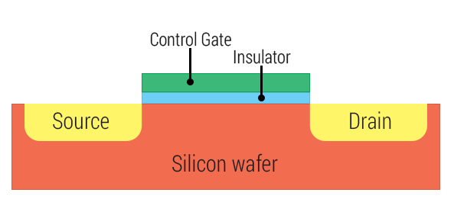


Motivation
Problem: SiGe and Ge form unstable oxides that inhibit device performance.
Need to find effective surface passivation method for SiGe and Ge
Passivation layer = coat of protective material that reduces the amount of chemical reactivity on the surface
Material | Hole Mobility (cm² V/s)
Silicon | 200
Germanium | 450
Del Alamo, Jesús A. "Nanometre-scale electronics with III-V compound semiconductors." Nature 479.7373 (2011): 317-323.
https://www.androidcentral.com/sites/androidcentral.com/files/styles/xlarge/public/article_images/2015/01/Transistor.png
2

Slide 3
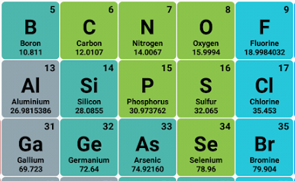
Background
Use elemental sulfur as passivation reagent.
Soluble in non-aqueous solvents
Forms oligomers (chains) on the surface
Chains could form multilayers which resist reoxidation.
Solubility of Sulfur in Various Solvents
Solvent | Solubility (mM)
Water | 1.9 x 10⁻⁵
Ethanol | 0.9
Benzene | 88
Jacques Boulegue, Taylor-France Online. Solubility of Elemental Sulufur in Water at 298 K,, 5(1), (2006)
3

Slide 4
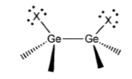
Objectives
Goal: Develop a non-aqueous process that deposits a sulfur passivation layer on SiGe 75%.
Passivation layer must protect the surface from reacting with ambient conditions.
SiO₂/GeO₂
sulfides
SiGe 75%
SiGe 75%
Control
Sulfur-passivated surface
4

Slide 5
Procedure
Control
Rinse 30 s in EtOH/benzene, N₂ dry
Cleaning and etching
SC-1 2 min
1:1:500 NH₄OH:H₂O₂:H₂O
UPW rinse 1 min, N₂ dry
HF/HCl Oxide strip 5 min
1:3:300 HF:HCl:H₂O
SiO₂/GeO₂
SiGe 75%
SiGe 75%
Passivation
(NH₄)₂S/S in EtOH/S in benzene passivation 20 min
1:100 (NH₄)₂S:H₂O/S in EtOH/S in benzene
Rinse 30 s in DIW/EtOH/benzene, N₂ dry
SiO₂/GeO₂
SiGe 75%
SiGe 75%
SiGe 75%
Sulfur passivation layer
5
SiGe 75%

Slide 6
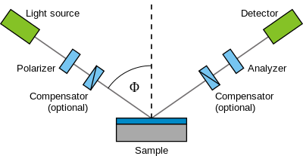
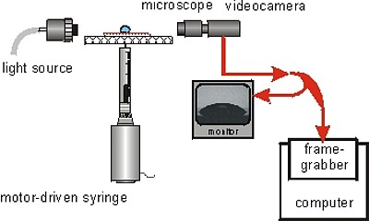
Characterization
Spectroscopic ellipsometry
Measured overlayer (sulfur and oxides) thickness
Goniometry
Measured water contact angle
Wikimedia Commons
The Leibniz Institute of Polymer Research Dresden
6

Slide 7
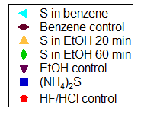
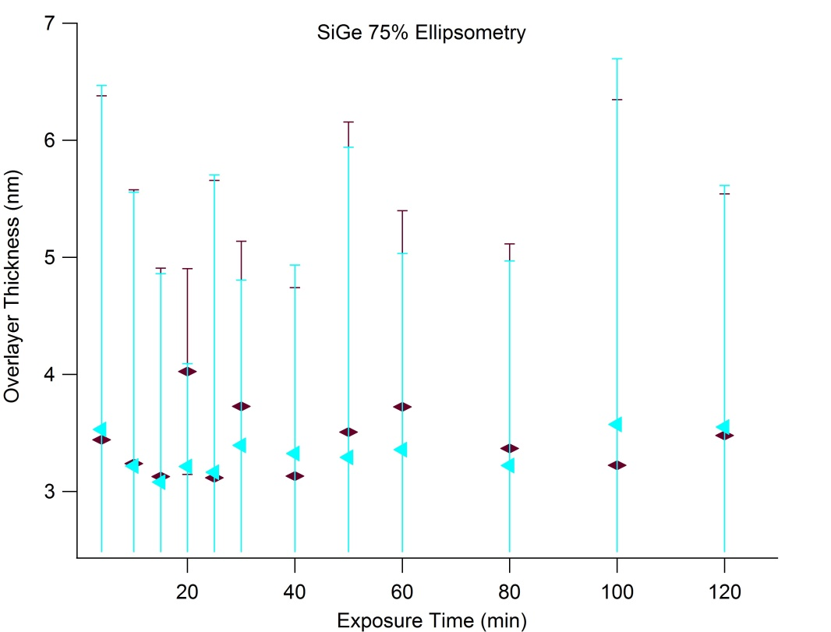
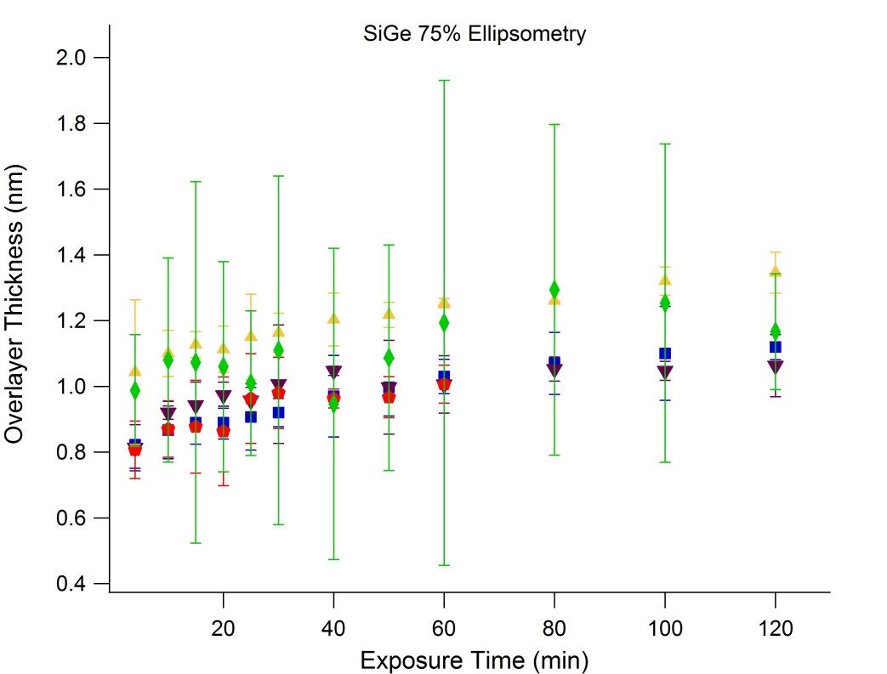
Surfaces treated with sulfur in benzene result in 3.6 ± 0.3 nm overlayer thickness.
Sulfur in ethanol shows a larger overlayer thickness than (NH₄)₂S and HF/HCl controls, but layer does not resist oxidation.
Benzene processes deposit a mixture of carbon and sulfur species.
7

Slide 8
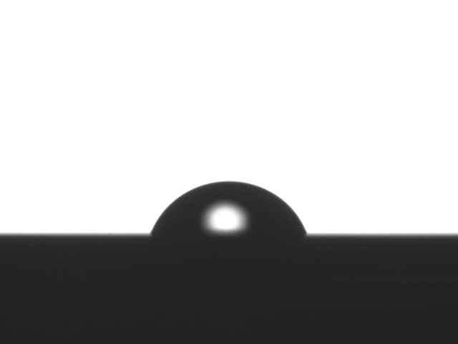
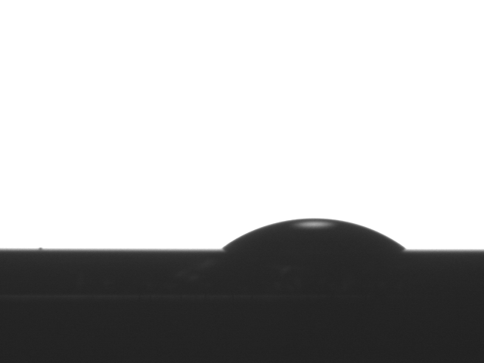
Surfaces treated with benzene are more hydrophobic than surfaces treated with ethanol.
Goniometry Data
Θ
Passivation Treatments | Water Contact Angle ( ° )
S in benzene | 69.3 ± 0.02
Benzene control | 61.8 ± 0.07
S in EtOH 20 min | 37.1 ± 0.06
EtOH control | 32.3 ± 0.11
(NH₄)₂S | 19.1 ± 0.06
HCl/HF control | 24.0 ± 0.11
Native oxide | 72.8 ± 0.06
S in benzene: hydrophobic
S in EtOH: hydrophilic
8

Slide 9
Results
Surfaces treated with sulfur dissolved in alcohols
Overlayer thickness of 1.4 ± 0.1 nm
Water contact angle of 37.1 ± 0.1°
Surfaces treated with sulfur dissolved in benzene
Overlayer thickness of 3.6 ± 0.3 nm
Water contact angle of 69.3 ± 0.02°
SiO₂/GeO₂/sulfides
carbon/sulfides
SiGe 75%
SiGe 75%
9

Slide 10
Conclusions
Surfaces treated with sulfur dissolved in benzene
Carbon and sulfur species present on surface.
Surfaces with sulfur in benzene → hydrophobic
Confirms carbon is present on surface
Surfaces with sulfur in alcohols → hydrophilic
Confirms oxides present on surface
Future Work
Analyze sulfur-treated surfaces using x-ray photoelectron spectroscopy (XPS)
Determine chemical species on surface.
Hybrid approach
Deposit single layer of sulfur on surface with ammonium sulfide to chemically satisfy dangling surface bonds.
Deposit multilayers of elemental sulfur in organic solvent on top to form diffusion barrier that resists reoxidation.
10

Slide 11

Acknowledgements
Muscat Research Group
NASA/Arizona Space Grant Consortium
Lam Research
11

Slide 12
Thank you!
12

